Slide 1
Oil to Plastic

Slide 2
How is Energy used to make a bottle research questions
Discuss questions

Slide 3
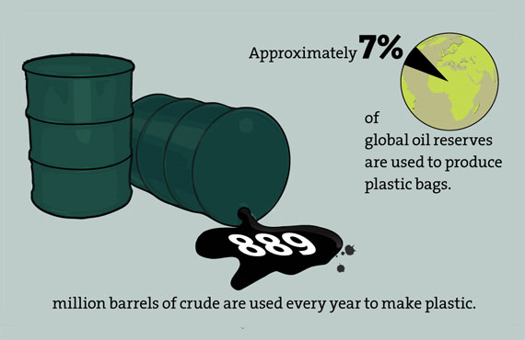
Oil to Plastic (9:06min)
https://www.youtube.com/watch?v=IwdUwffecsM

Slide 4
What are the different types of energy and which one do we use the most?

Slide 5
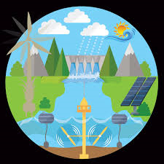
Types of Energy Resources
Renewable –Can be replaced in a short amount of time
- examples: hydroelectric, solar, geothermal, biomass, nuclear fusion, and wind
-benefits: creates little to no pollution

Slide 6
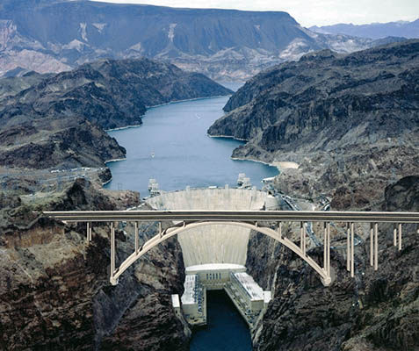
Hydroelectric -electricity generated using the
energy of moving water

Slide 7
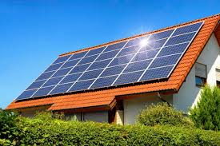
Solar Power – Uses solar cells to transfer the energy from the sun into electrical energy
Advantages – Free, produces no waste

Slide 9
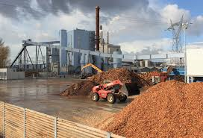
Biomass – a renewable energy source derived from organic matter such as wood, crop waste, or garbage. Burned in combustion facilities that generate heat and convert heat into power

Slide 10
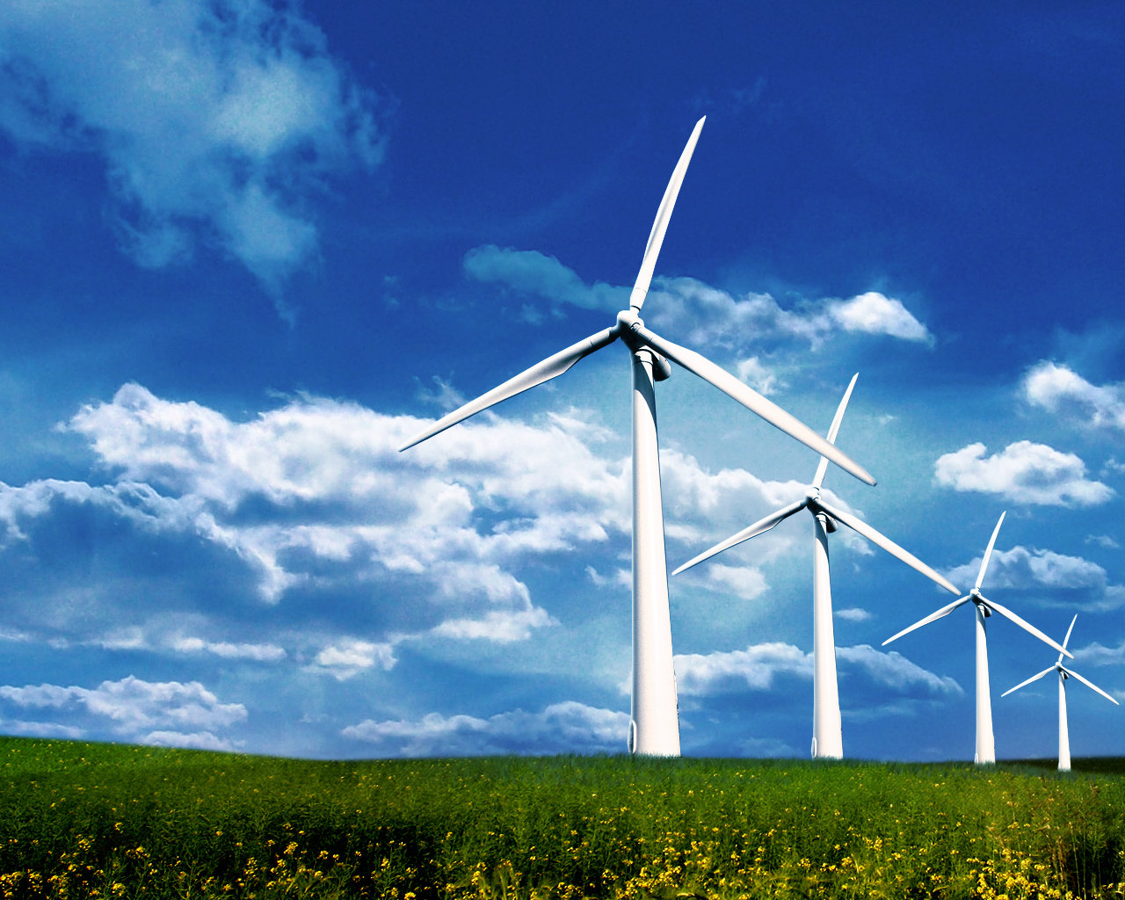
Wind Turbines - capture kinetic energy from the wind and generate electricity.

Slide 11
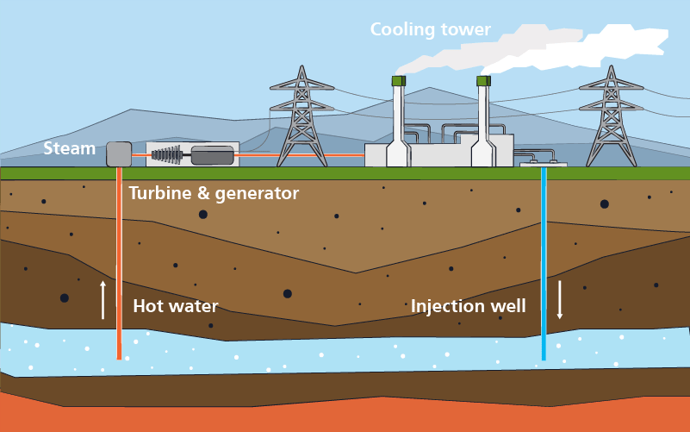
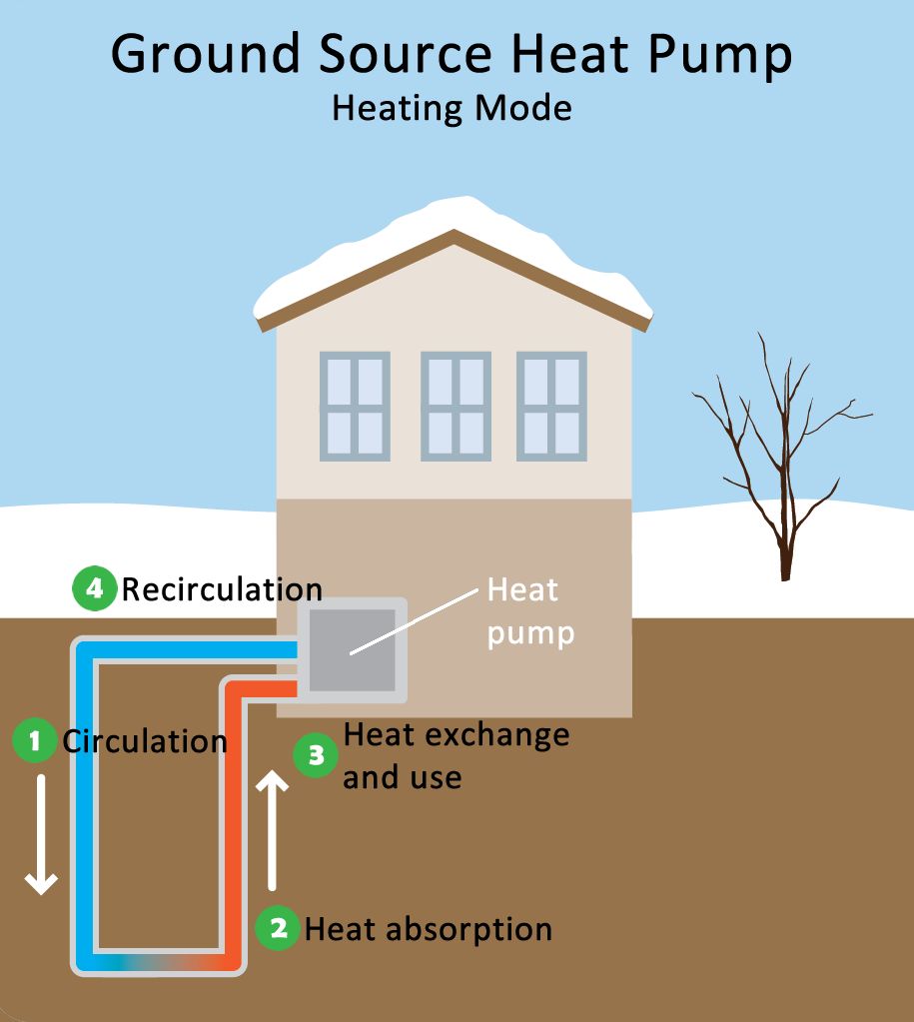
Geothermal thermal energy generated and stored in the Earth that can be used to heat homes and generate electricity.

Slide 12
What are the benefits of renewable resources?
Easily regenerated, can boost economic growth, easily available, supports environment, low maintenance cost, reduce carbon emissions

Slide 13
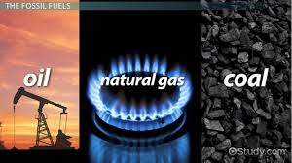
Types of Energy Resources
Nonrenewable – exist in limited quantities and cannot be replaced quickly, it takes millions of years to replenish the resource.
- examples: fossil fuels such as
oil, natural gas, coal, and uranium (nuclear energy)
- problems: creates pollution, fossil fuels will run out

Slide 14
What is the impact of Mining/using nonrenewable resources like fossil fuels?

Slide 15
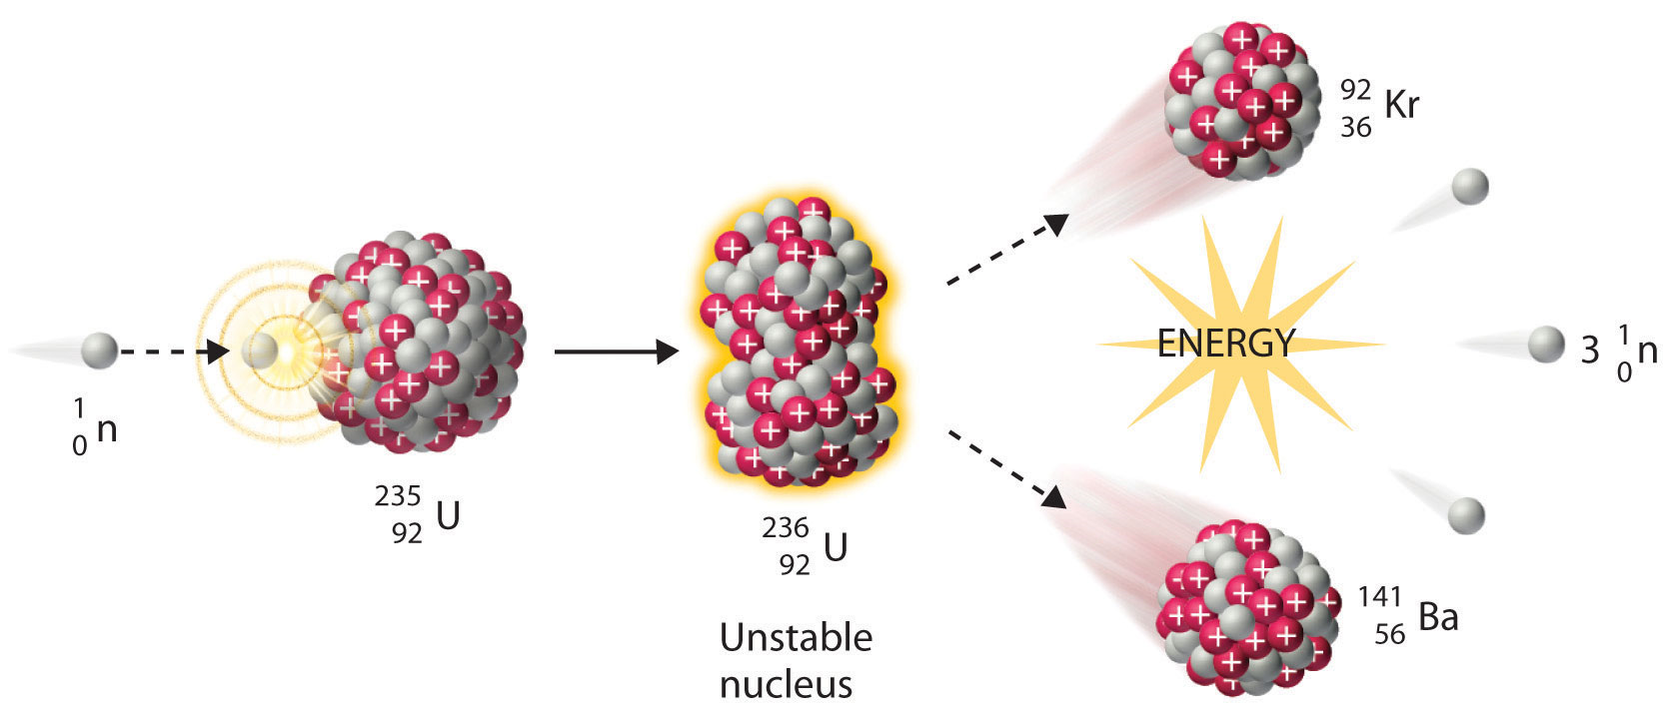
NUCLEAR ENERGY
Nuclear fission uses uranium to create energy, once the uranium is used, it is gone!
By-product highly toxic, it can cause cancer.

Slide 17
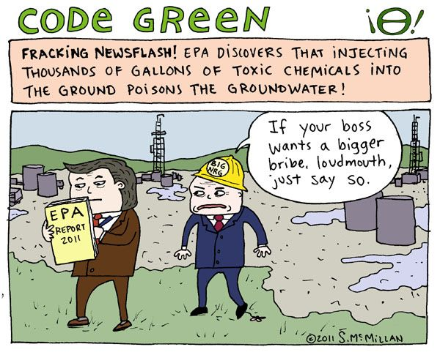
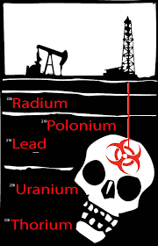
Problems with Fracking

Slide 18
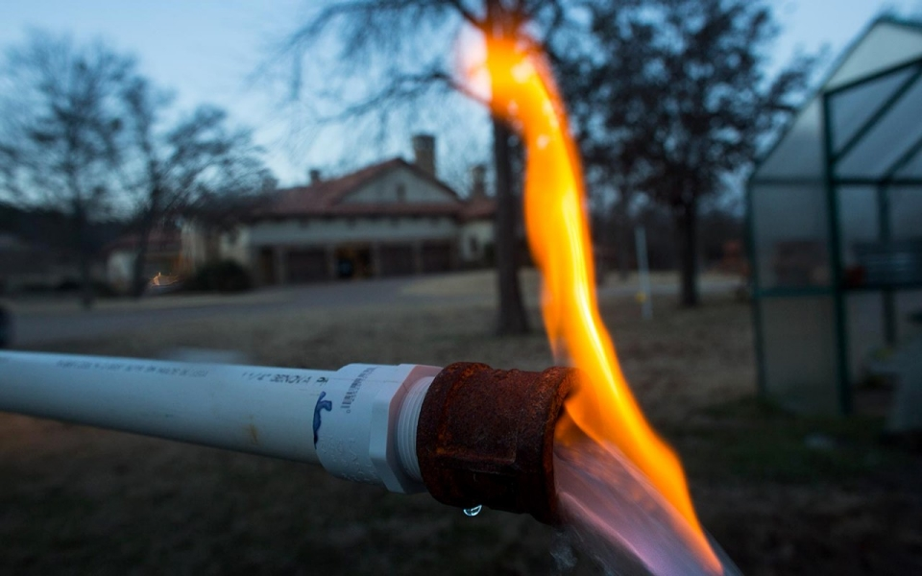
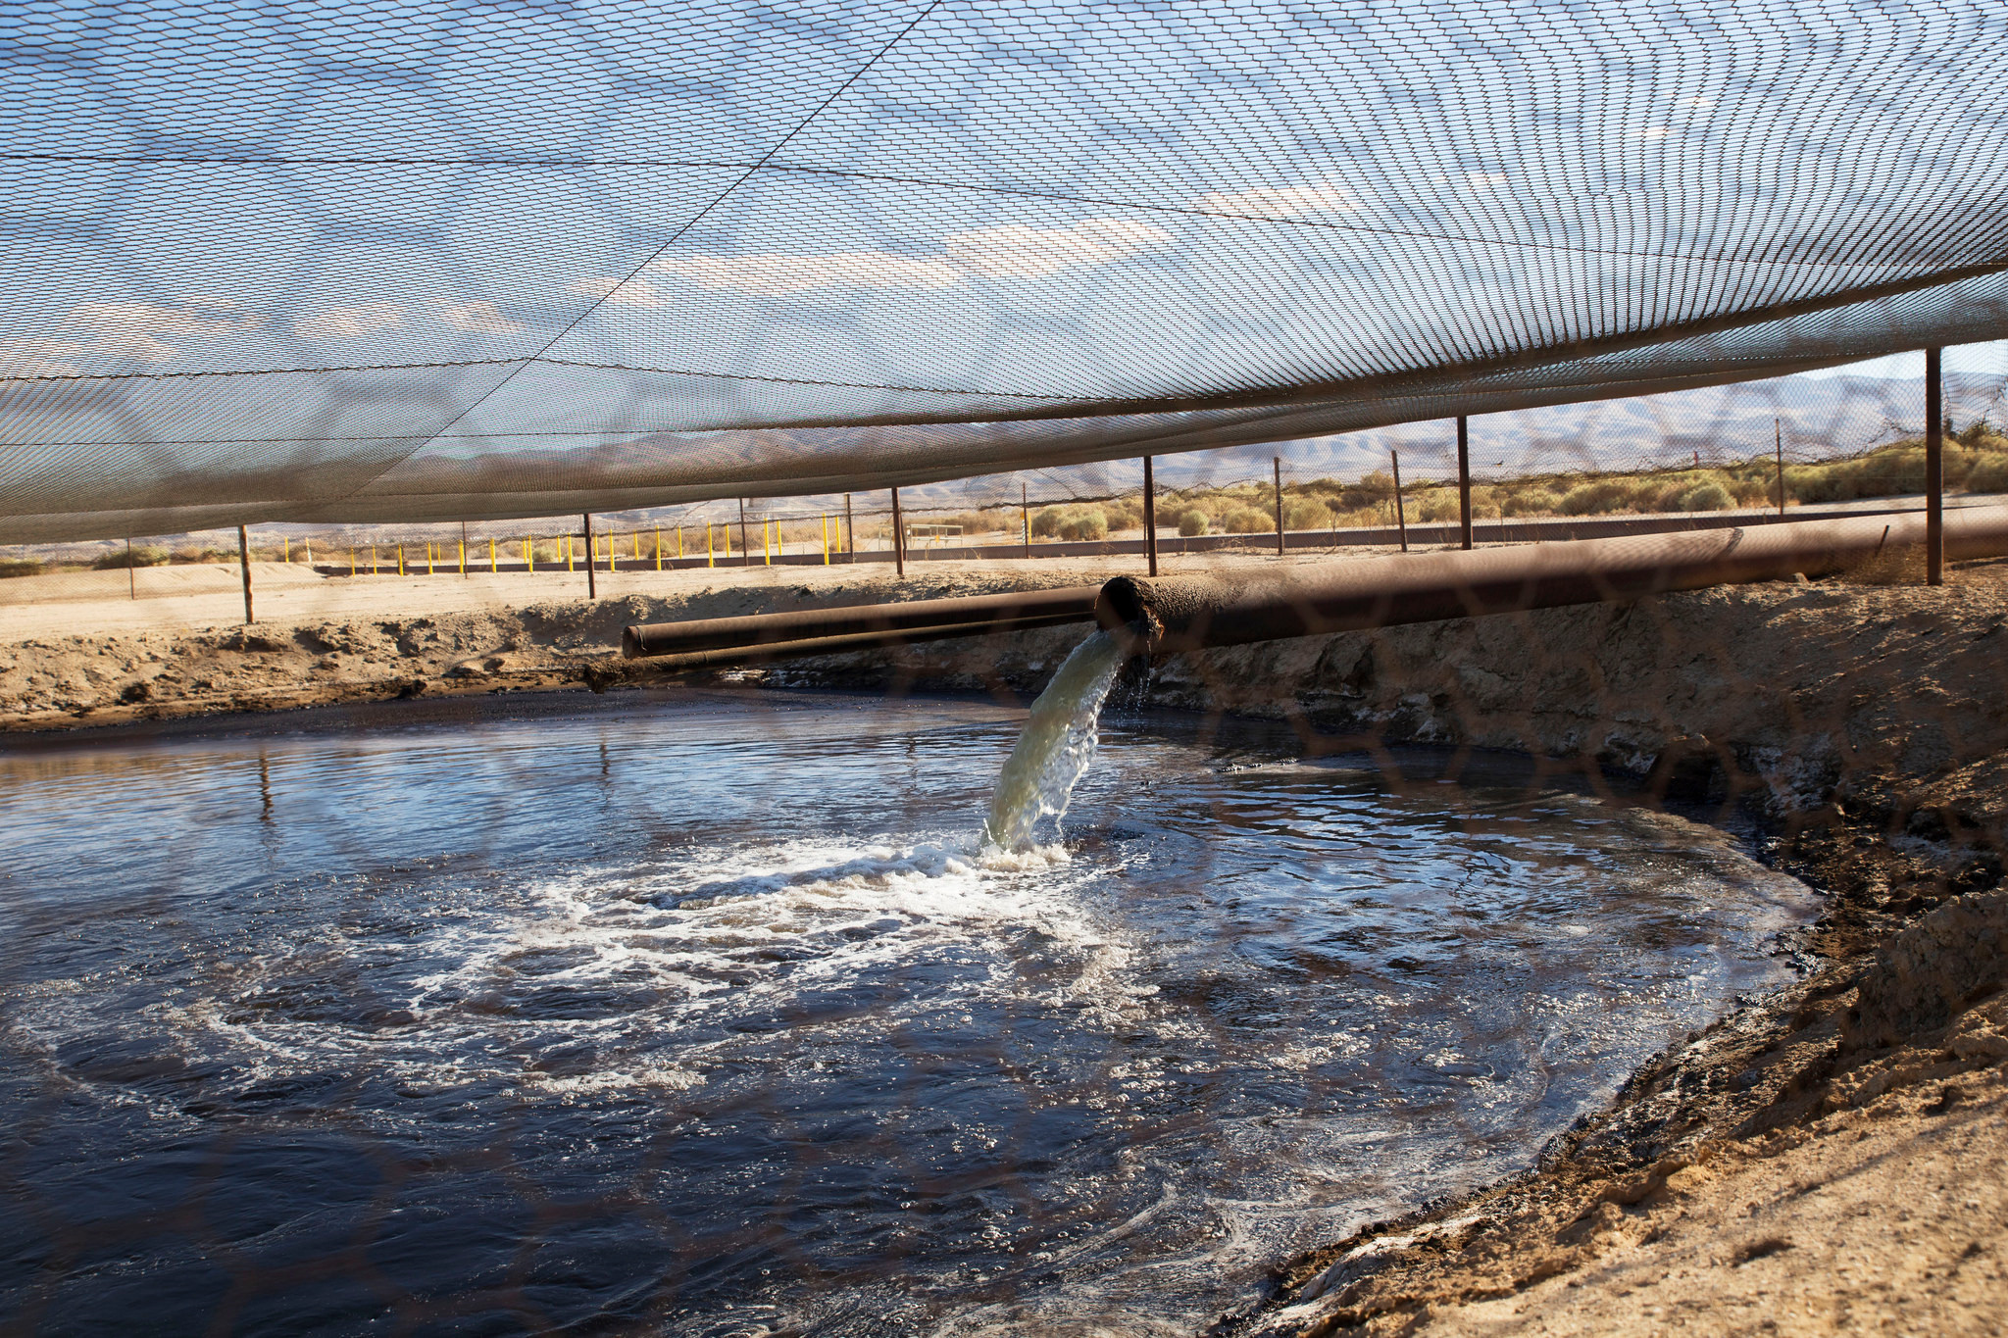
Methane in water due to fracking
Fracking waste pipe

Slide 19
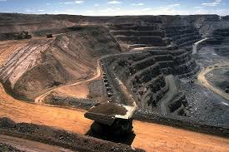
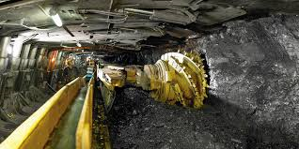
Mining affects on the environment
Mining​- explosives are used first in order to break through the surface of the mining area. The overburden or ground surface layer is then removed. Once the coal seam is exposed, it is drilled, fractured and thoroughly mined in strips.
Notes:
Add a picture

Slide 20
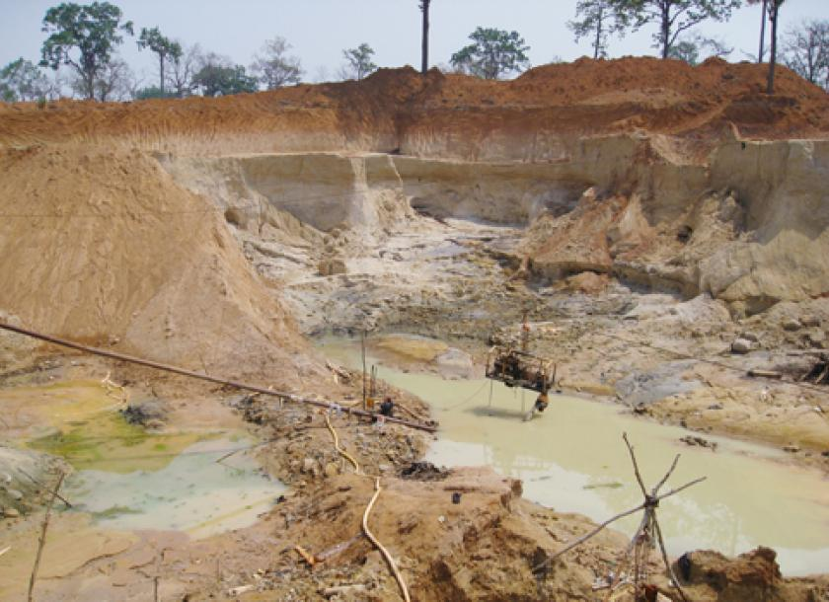
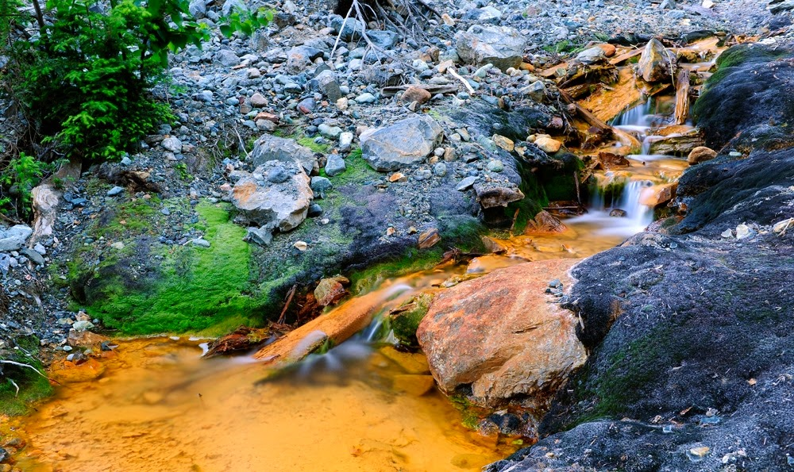
Mining’s Environmental Impacts
Communities are forced off their land by expanding mines, coal fires, subsidence (sinking land due to mining), and contaminated water supplies.
Mining destroys forests and soils.
But once the coal is gone, the problems they leave behind, like acid mine drainage, can persist for decades.

Slide 21
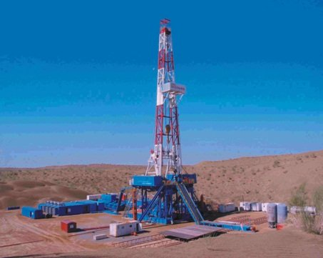
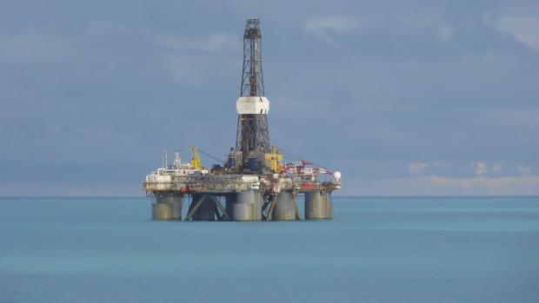
Drilling affects on the environment.
Drilling​-Oil drilling is the process by which tubing is bored(drilled) through the Earth's surface. A pump is connected to the tube and the petroleum under the surface is forcibly removed from underground.

Slide 22
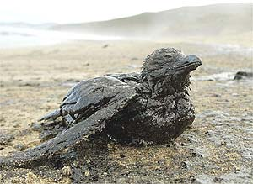
Drilling Environmental impacts (impact of fossil fuels)
1. Disruption of wildlife migration routes
and habitats from noise pollution, traffic and fences
2. Oil spills on land and offshore drilling sites
3. Landscape changes from well pads and roads
4. Oil and gas infrastructure and traffic spoil peaceful settings for visitors
5. Haze, toxic chemicals and dust pollute the air and water
6. Machinery, gas flares and light pollution disrupt scenic views and clear night skies
7. Dangerous methane emissions contribute to climate change
Notes:
There was an article this info came from if you want to elaborate. It might be to long so we can take out the ones that are not related to water.

Slide 23
Recap: Cons for using fossil fuels
Non renewable
Can pollute ground and surface water
Causes increase amount of CO2 (greenhouse gas)
Causes acid rain with burning of fossil fuels
Health risks to the miners….
The fission of uranium A highly toxic byproduct is produced, causes cancer.
Destroys habitat

Slide 24
If fossil fuels like oil can cause so much problems, why do we use them?

Slide 25
We use oil to make plastic.
Drill Oil
Refine Oil
Pellets
Melt Pellets
Mold into plastic
Think about the energy used in making and transporting product
Notes:
Could add slide in on process of making plastic again.

Slide 27
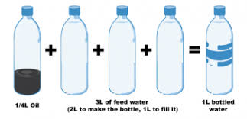
How much water and Fossil fuels are used to get 1 liter of water?
¼ Oil 3L of “feed” water 1L bottled water
(2L to make the bottle, 1L to fill it)
Does this make you think twice before using single use plastic?

Slide 28
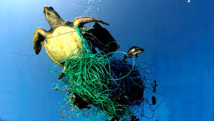
Reasons why we should not use single use plastics….
Over 70 billion single use plastic water bottles are consumed annually in the US and Europe.
Bottled water is commonly more expensive than gas.
By consuming bottled water you are contributing to killing over 1 million sea birds and 100,000 mammals annually who die ingesting or becoming trapped in plastic waste.
Notes:
Go through the diagram. Just as previous slides go into energy used and how much water and fossil fuels are used now the impact. This slide should help with CER info.

Slide 29
More reasons why we should not use single use plastics…
Made from fossil fuels
Huge carbon foot print (how much carbon is emitted)
Will still be here in hundreds of years…it takes 500 years to degrade
Only a tiny percentage is recycled
Leaches toxins into food and drink
Causes hormone disruptions and cancers
Enters our food chain through micro plastics
Notes:
Could change title to the first statement or just plastics verses FF too.Need to go over carbon footprint. We could put this slide into words instead of using image.. Again info should help them withCER

Slide 30
What does environmental friendly mean?
Environmentally friendly or environment-friendly, (also referred to as eco-friendly, nature-friendly, and green) are sustainability and marketing terms referring to goods and services, laws, guidelines and policies that claim reduced, minimal, or no harm upon ecosystems or the environment.
Whenever we process goods we need to think about what are the potential impacts on water and how can we reduce our impact on the environment.

Slide 31
Reminder
You will have a Quiz next class!

Slide 32
CER
Will eco-designed single use water bottles have much of an impact on protecting the environment?

Slide 33
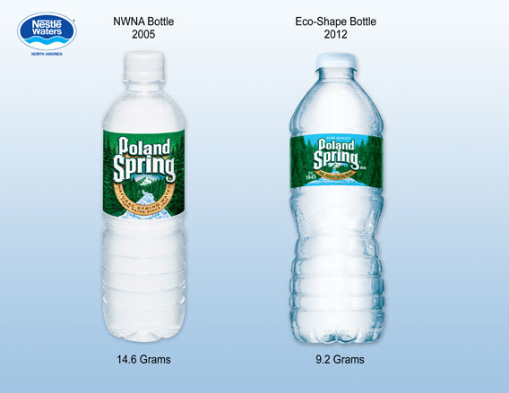
Comparison of old bottle and new eco designed bottle

Slide 34
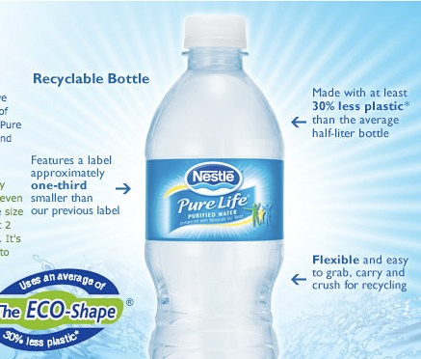
Eco design features

Slide 35
Quiz

Slide 36
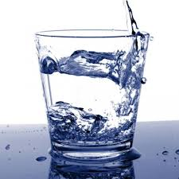
Taste Test
Which water do you prefer,
water A or water B?

Slide 37
The Story of Stuff Bottle Water (8min)
https://www.youtube.com/watch?v=Se12y9hSOM0

Slide 38
Video: Plastic Paradise
Please complete your worksheet while you watch the video.

Slide 39
Group Reading and Share
Your group will be given an article to read, you need to discuss the article with your group, then share what you have learned with the class.
Notes:
Water Pods, Single use bags, microplastics

Slide 40
Engineering Task
Design a Solution to the Great Pacific Garbage Patch.
**Descriptive text is key**
Watch the video’s to get some ideas…..

Slide 41
Examples of Solutions to water pollution
Marine Litter Extraction watch from 7:20 – 10:20
Floating Bin 56 seconds long
Solar Powered Water Wheel 4:44 long

Slide 42
Bibliography
https://www.greenpeace.org/archive-international/en/campaigns/climate-change/coal/Coal-mining-impacts/
https://wilderness.org/seven-ways-oil-and-gas-drilling-bad-news-environment

